Slide 1
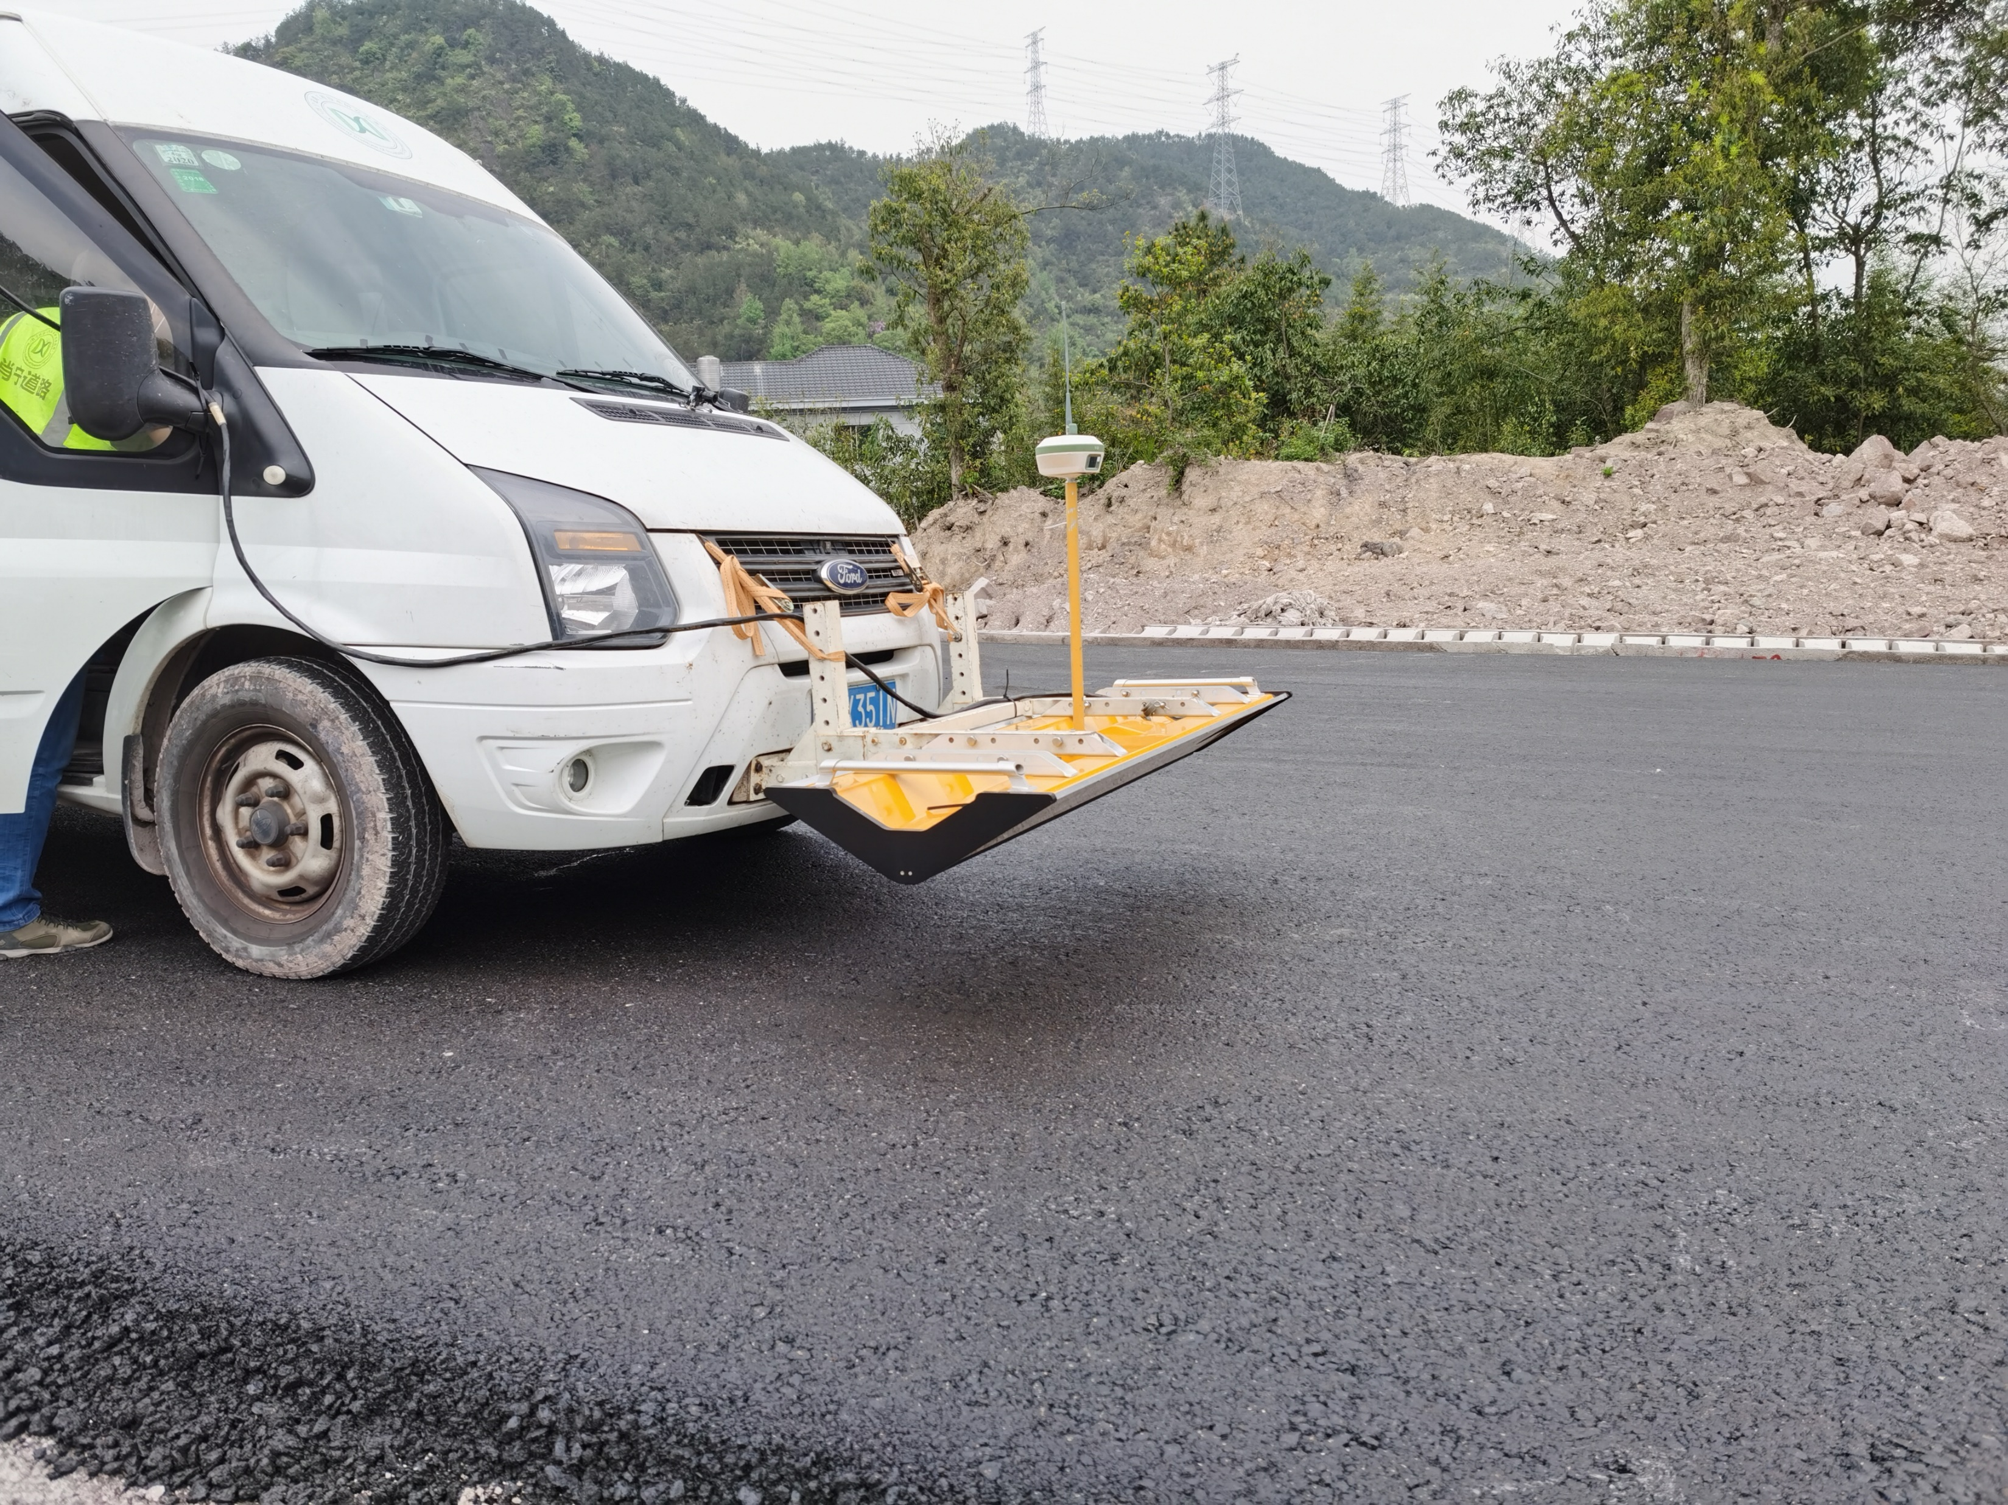
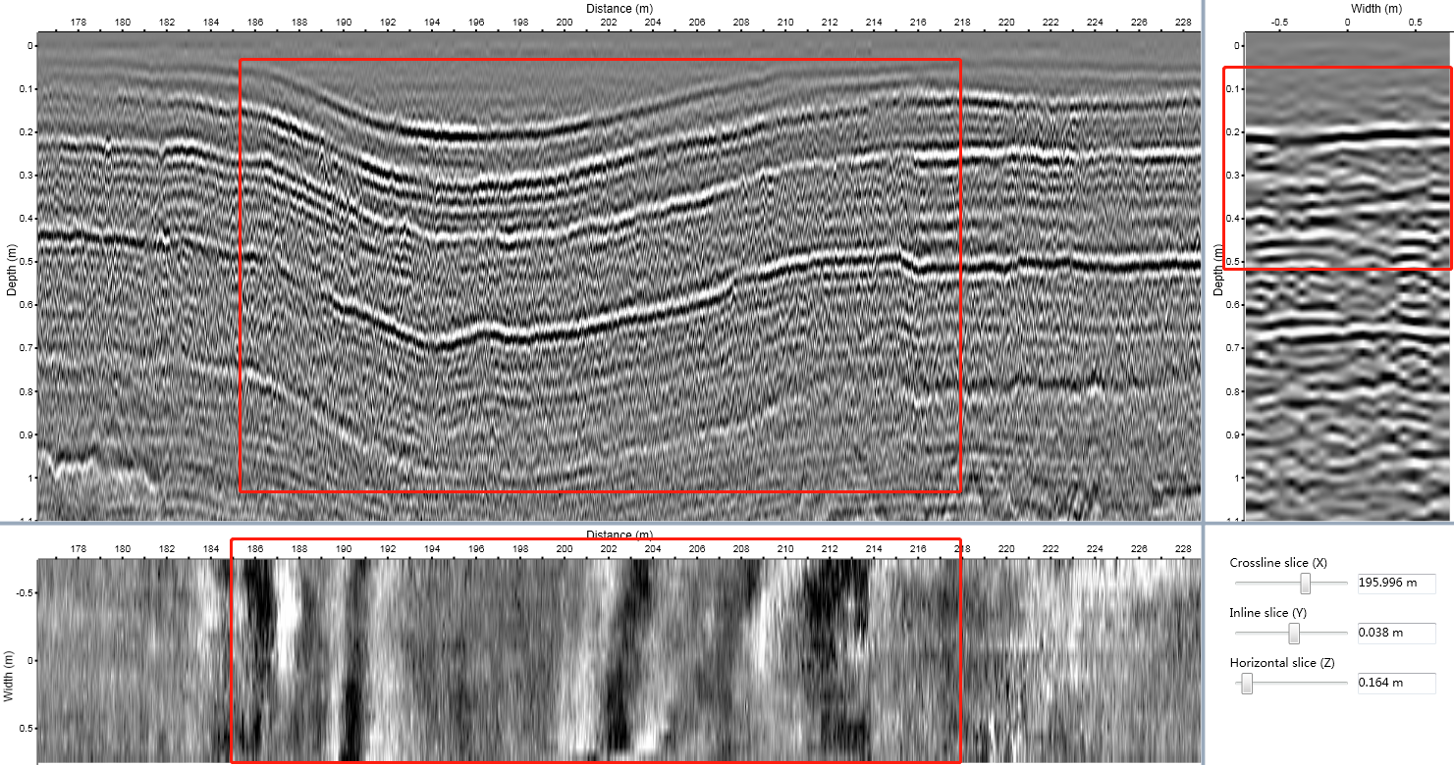
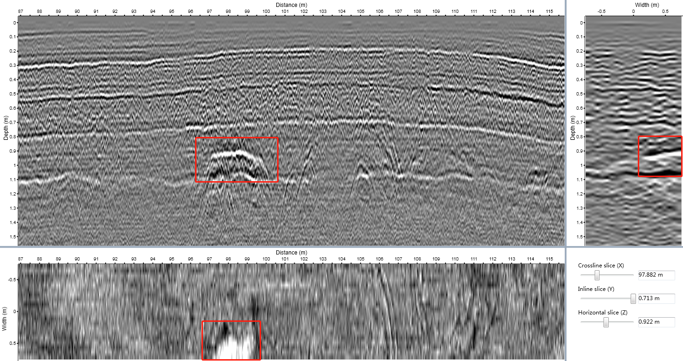
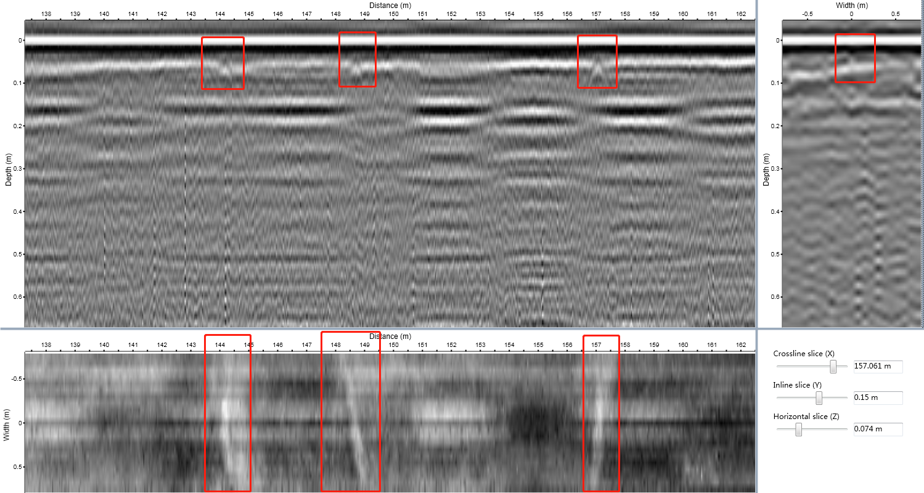
Uneven sinking
Track
3D-GPR
Pavement voids
Antenna
1
2
3
4
5
6
7
8
9
10
11
12
13
14
15
10
11
12
13
14
15
1
2
3
4
5
6
7
8
9
Pavement Cracks
Deep Learning methods to process these images automatically and precisely

